Slide 1
DECISION TREE & RANDOM FOREST MACHINE LEARNING ALGORITHM

Slide 2
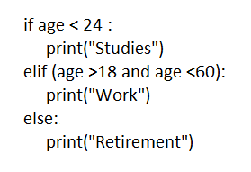
Age < 24
(C1)
Decision Tree – Intuition
Classification and Regression Trees(CART)
Parent Node or
Root Node
yes
No
Age >18 and < 60
(C3)
Studies
(C2)
Decision node
yes
No
leaf node
Work
(C4)
Retire
(C4)
Sub Tree or
Branch

Slide 3
Splitting Phenomena (Pure and Impure)
Climate | Play Cricket
Hot | Yes
Overcast | Yes
Rain | No
Overcast | Yes
Rain | No
Hot | Yes
Overcast | Yes
Rain | No
Hot | No
Rain | No
Overcast | No
Hot | yes
Hot | 3Y/1N
Overcast | 3Y/1N
Rain | 4N
Climate
(play /not play)
3Y/1N
3Y/1N
4N
Hot
Overcast
Impure node
Rain
Impure node
Pure node
3Y
1N
3Y
1N

Slide 4
c1
Key assumptions in pure split?
Entropy
6Y/3N
3Y/3N
3Y/0N
H(S) = - (P+)log2(P+) – (P-)log2(P-)
Where, P+ = probability of ‘yes’
P- = Probability of ‘No’
c2
c3
C1 | C2 | C3
P+ = 6/9 P- = 3/9 H(S) > -(6/9)log2(6/9)-(3/9)log2(3/9) H(S) = 0.92 | P+ = 3/6 P- = 3/6 H(S) > -(3/6)log2(3/6)-(3/6)log2(3/6) H(S)=1 | P+ = 3/3 P- = 0/3 H(S) > -(3/3)log2(3/3)-(0/6)log2(3/3) H(S) = 0
1
0.5
0
H(S)
H(S) ranges between 0 to 1
Pure Split >>> H(S) = 0
Impure Split >>> H(S) = 1
0 0.5 1 P+,P-

Slide 5
c1
Key assumptions in pure split?
Gini Impurity or Gini Index or Gini Coefficient
6Y/3N
3Y/3N
3Y/0N
G.I = 1 – [ (P+)^2 + (P-)^2 ]
Where, P+ = probability of ‘yes’
P- = Probability of ‘No’
c2
c3
C1 | C2 | C3
P+ = 6/9 P- = 3/9 G.I > 1-[(6/9)^2 + (3/9)^2] G.I = 0.444 | P+ = 3/6 P- = 3/6 G.I > 1-[(3/6)^2 + (3/6)^2] G.I=0.5 | P+ = 3/3 P- = 0/3 G.I > 1-[(3/3)^2 + (0/3)^2] G.I = 0
0.5
0
G.I
G.I ranges between 0 to 0.5
Pure Split >>> G.I = 0
Impure Split >>> G.I = 0.5
0 0.5 P+,P-

Slide 6
Feature Prioritization
Information Gain
F1
9Y/6N
Gain(S, Feature) =H(Sf) - Є( H(Sv) * (Sv /S) )
Where, H(Sf) > > Entropy of root node of feature
H(Sv) >> Entropy of leaf node
(Sv/S) >> Ratio of probability
6Y/3N
3Y/3N
c1
c2
Information Gain for F1
H(Sf) = [ -(9/15)log2(9/15)-(6/15)log2(6/15) ] = 0.971 H(Sv) for c1 > -(6/9)log2(6/9)-(3/9)log2(3/9) = 0.92 H(Sv) for c2 > -(3/6)log2(3/6)-(3/6)log2(3/6) = 1 (Sv/S) for c1 > 9/15 (Sv/S) for c2 > 6/15 Gain(S,F1) = 0.971 – [ (9/15)*0.92 + (6/15) * 1] = 0.019
Suppose assume there are another two features,
And , Gain(S,F2) = 0.029
Gain(S,F3) = 0.049
Here Gain(S,F3) >> Gain(S,F1) and Gain(S,F2)
So With Feature F3 split should be started

Slide 7
Key Points
Entropy Vs Gini Impurity
Entropy embodies log function | Gini Impurity is of simple mathematics
Entropy Calculation consumes more time | Gini Calculation consumes less time
If dataset contains less number of features , Entropy is recommended | If dataset contains more number of feature i.e (above 50) , Gini is recommended.
Amount
< 5000
c1
Consider a multi feature classification dataset
Id | Amount | Status
1 | 2000 | good
2 | 5000 | bad
3 | 3000 | Good
4 | 7000 | Bad
5 | 15000 | Bad
6 | 1000 | good
7 | 6000 | Bad
3 Instances
4 Instances
Suppose enquiry is 4500 amount >> It falls into c5 leaf node
Information gain gives idea about from which feature to start the split
Good
or Bad
c2
Good
or Bad
c3
3 Instances
4 Instances
3
Good
c5
0 Bad
c6
0
Good
c7
4 Bad
c8

Slide 8
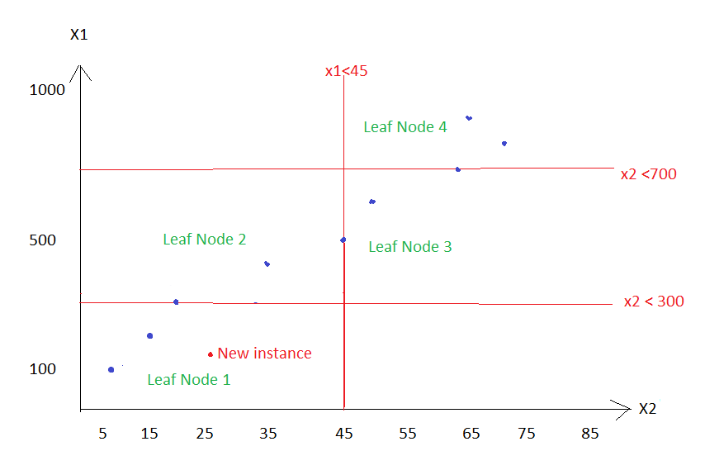
Decision Tree Regression
X1 | X2 | Y
100 | 5 | 0.5
200 | 15 | 1.5
300 | 20 | 2.5
400 | 35 | 3.5
500 | 45 | 4.5
600 | 50 | 5.5
700 | 65 | 6.5
800 | 75 | 7.5
900 | 70 | 8.5
X2 <45
Yes
4 rows
No
5 rows
X1 <300
X1 <700
Yes
No
Yes
No
When New Instance falls in particular Leaf Node , prediction y is dependent to data points present in particular node.
Here cost function MSE is used
Leaf node is assured with lowest cost function
No Gini and Entropy
2 rows
2
rows
2
row
3
rows
L1
L2
L3
L4

Slide 9
Role of Information Gain in Decision Tree Regressor How to instantiate feature split:
Choice 1
Choice 2
Choice 3
F1
2.5
3.7
4.1
5.2
6.3
7.2
8.2
F1>3.7
F1>2.5
F1>4.1
No
Yes
No
Yes
No
Yes
>>> Choice N
1 row
6
rows
2
rows
5
rows
3
rows
4
rows
Information Gain for all choices is getting calculated.
Finally best information gain and corresponding split is selected

Slide 10
Hyperparameter Optimization:
Pruning: (To prevent overfitting)
7Y/
7N
4Y/3N
6Y/1N
Pruning or cutting the branch
3Y/3N
1Y/0N
2Y/2N
1Y/2N
3Y/0N
3Y/0N
2Y/0N
2Y/0N
1Y/0N
2Y/0N

Slide 11
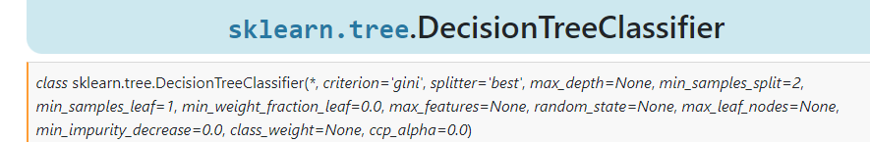
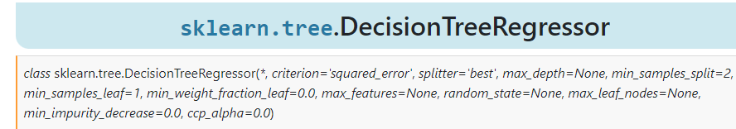
Pruning Continue…….
https://scikit-learn.org/stable/modules/generated/sklearn.tree.DecisionTreeClassifier.html
https://scikit-learn.org/stable/modules/generated/sklearn.tree.DecisionTreeRegressor.html
*** Parameterizing Max_depth is hyper tuned by cost complexity pruning

Slide 12

ENSEMBLE METHODS
CUSTOMIZED ENSEMBLE - BAGGING
Training Data
Training Sample 1
Training Sample 2
Training Sample 3
Training Sample 5
Training Sample 6
Logistic Regression
Linear Regression
Decision Tree
Support Vector Machining
K nearest neighbours
Test Data
0
1
1
1
1
Classification
2
4
2
3
5
Regression
(Mean)
BOOTSTRAP AGGREGATOR / MAJORITY VOTING

Slide 13
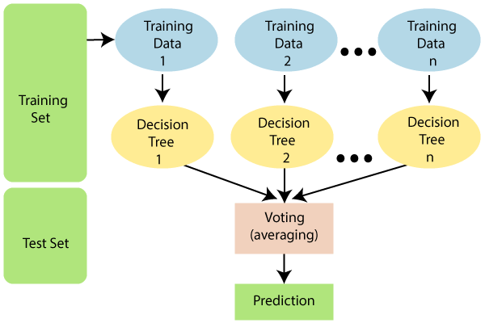
Random Forest

